Slide 1
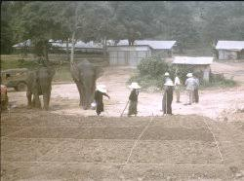
Soil Compaction By Elephant

Slide 2
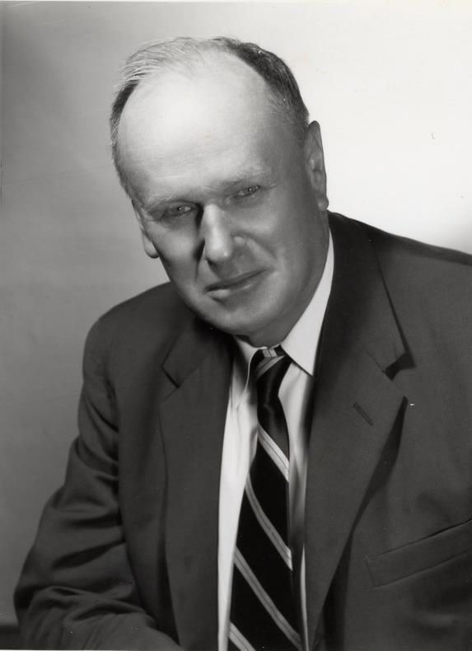
R R Proctor
First Scientific Study on Soil Compaction is Done by Ralph Roscoe Proctor
During the construction of Bouquet Canyon Dam (1932 to 1934), he observed that compaction is related to moisture content and comapcive effort.
He developed what we now call the "Proctor-test", to determine the optimum water content of the compacted earth fill used for the dam core construction.

Slide 3
Proctor Curve
The aim of the test is to establish the maximum dry density that may be attained for a given soil with a standard amount of compactive effort. When a series of samples of a soil are compacted at different water content the plot usually shows a distinct peak.
ρ_{d max}
Zero air voids line
ZAV
Dry Density
Soil too dry and brittle
Soil too wet & deformable
OMC
Moisture content

Slide 4
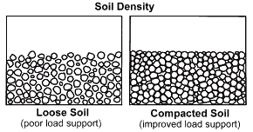
Compaction Mechanism
Compaction (concept): the densification of soil by removal of air. Requires mechanical energy Densification increases with help of water.
water acts as softening agent and allows soil particles to slip over one another thereby increasing the packing factor

Slide 5
Factors Affecting The Compaction
Factors | Control
Nature and type of soil, i.e. sand or clay, grading, plasticity | No Control. Depends on material availability
Water content at the time of compaction | Controllable
Site conditions, e.g. weather, type of site, layer thickness | Controllable by choosing proper combination of equipment and lift thickness
Compactive effort | Controllable by choosing proper combination of equipment and lift thickness

Slide 6
Laboratory Compaction Tests
Standard Proctor Test: -
mould 4.6” * 4” diameter
hammer weight = 5.5 Ib
height of hammer drop = 12”
No. of blows/layer = 25 No. of layers = 3
Modified Proctor Test: -
mould 4.6” * 4” diameter
hammer weight = 10 Ib
height of hammer drop = 18”
No. of blows/layer = 25
No. of layers = 5
Modified proctor is: -
more hammer weight
more hammer drop distance
more no. of layers

Slide 7
Role of Compactive Effort
The compactive effort will be greater when using a heavier roller on site or a heavier rammer in the laboratory. With greater compactive effort:
maximum dry density increases
optimum water content decreases
air-voids content remains almost the same.
Modified Compaction
Dry Density
Standard Compaction
Moisture content

Slide 8
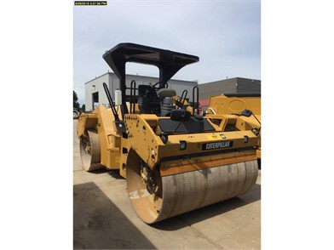
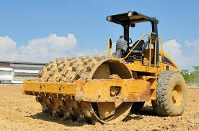
Compactive Effort
Smoothed drum Roller | 20 psi to 50 psi
Sheep's Foot Roller | 175 psi to 700 PSI

Slide 9
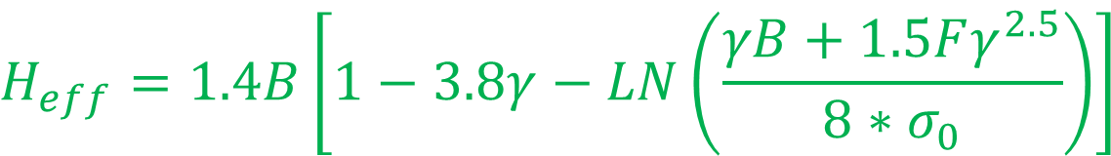
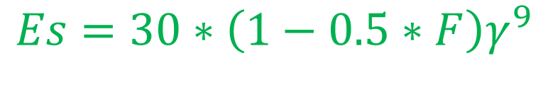
Can We design Soil Compaction?
Yes
“Mathematical Approach to Simulate Soil Behavior under Shallow Compaction” by Ahmed M .Ebid
$$Es=30∗\left(1−0.5∗F\right)γ^{9}$$
$$H_{eff}=1.4B\left[1−3.8γ−LN\left(\frac{γB+1.5Fγ^{2.5}}{8∗σ_{0}}\right)\right]$$

Slide 10
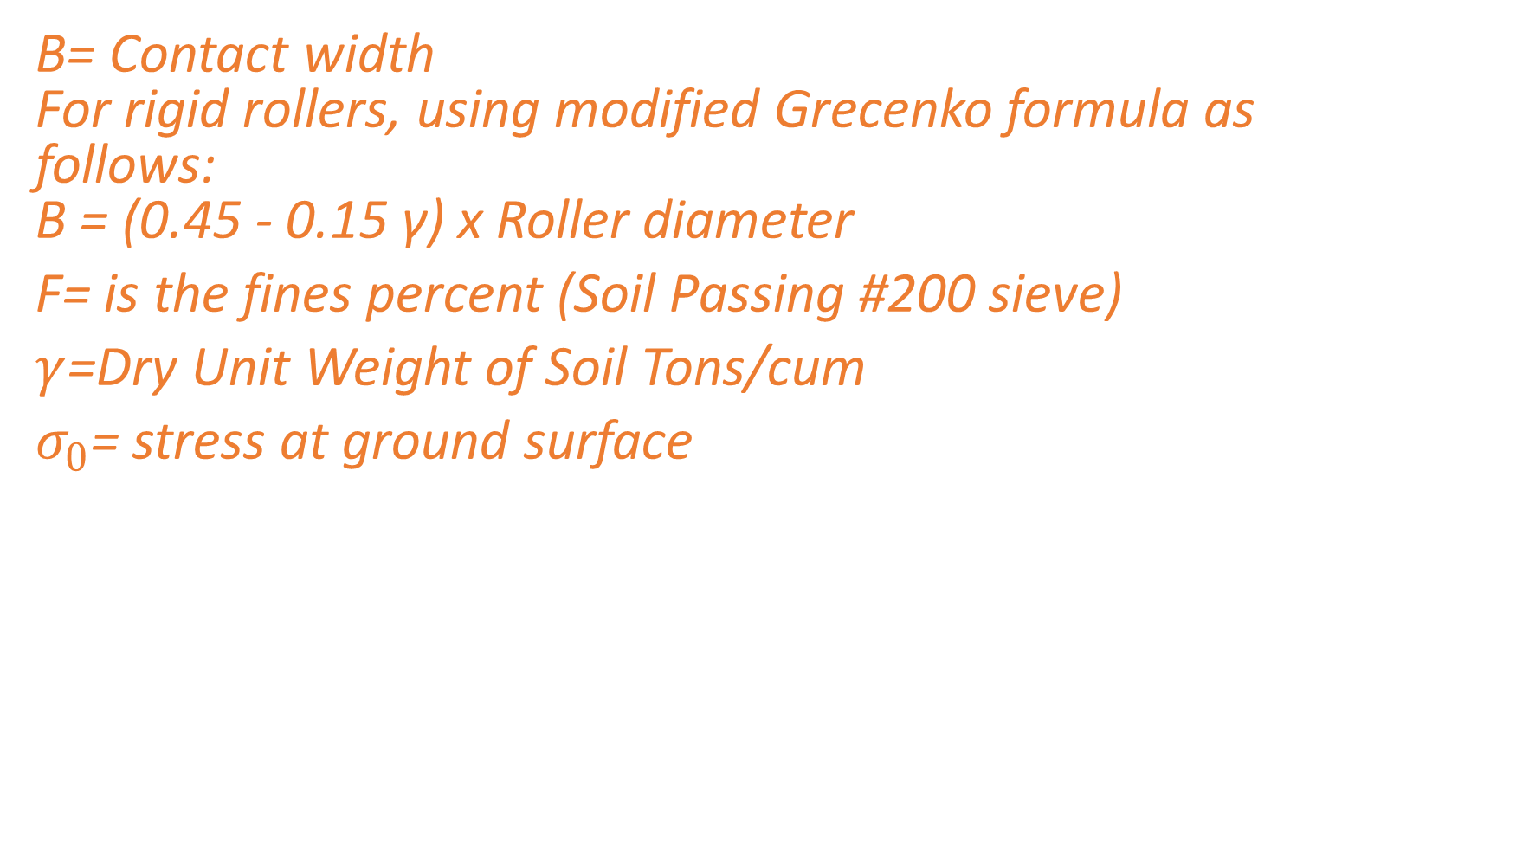
Parameter for Soil Compaction design
B= Contact width For rigid rollers, using modified Grecenko formula as follows: B = (0.45 - 0.15 γ) x Roller diameter
F= is the fines percent (Soil Passing #200 sieve)
$γ$=Dry Unit Weight of Soil Tons/cum
$σ_{0}$= stress at ground surface

Slide 11
Proposed Procedure for Soil Compaction Design ?
The proposed approach depends on calculating the lift settlement after each pass considering the fact that only effective depth is affected by compaction effort
accordingly fill proprieties will be updated to be used to calculate the settlement of the next pass.
Pass after pass, the effective depth decreases due to ultimate bearing capacity enhancing until it equal to zero when the ultimate bearing capacity exceeds the effective contact stress,
at this time, the dry density reaches its maximum value and any mare passes will not have any effect on the soil.

Slide 12
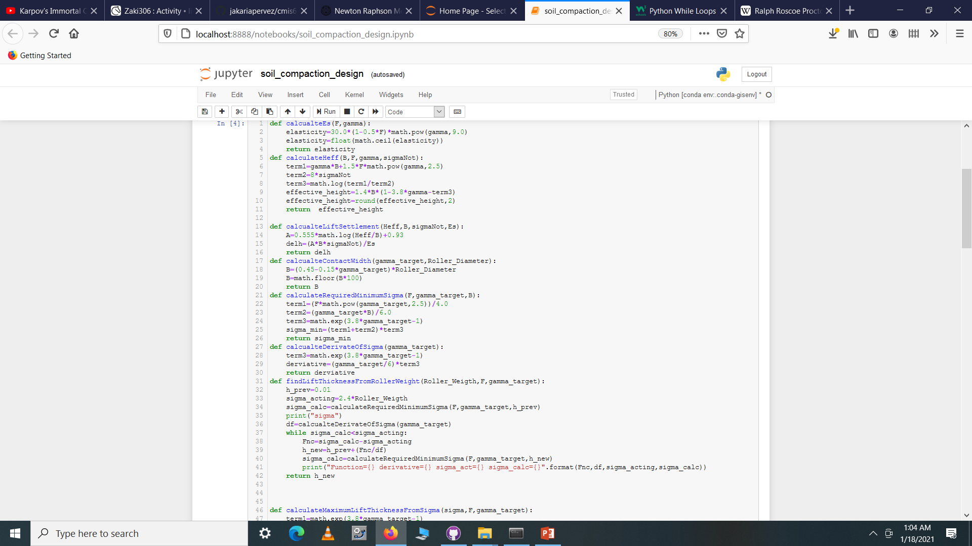
Computer Program for Soil Compaction Design?
Based on Ahmed M .Ebid’s equation we developed a small computer programm

Slide 13
Computer Program for Soil Compaction Design?
Result are not so good
For Soil with 10% clay Particle
For initial Dry Density=1.39 mton/cum (87 lb/cft)
To Attain Final Dry Density=1.75mton/cum (109 lb/cft)
With 20 ton smoothed drum roller
Maximum lift thickness=22 cm
No of Passes=15

Slide 14
Conclusion
Ebid’s equation is Reasonable for Sand.
It’s very sensitive for fine grained soil which contains clay.
Further Improvement Can be Done.

